Slide 1
T-Level Health; Supporting Adult Nursing Induction
This is the course textbook
Name:
Please email completed documents to Leah by Friday 18th Aug 2023.
If you have any questions, please email:
Leah Marshall leahg@shrewsbury.ac.uk

Slide 2
Contents
What will I be studying? Page 3
Recommended Netflix Programmes Page 4
Other recommended watching Page 5
Recommended Reading Page 6
Representations Task Page 7
Learning Log Page 8
Key word Glossary Page 9-10
A-Z Challenge Page 11
History of the NHS Page 12
Roles in Health and Social Care Page 13
Frontline roles in a pandemic Page 14
True or False Page 15
Extension Task Page 16-20
Checklist for September Page 21

Slide 3
What will I be studying?
The course in Year 1 is assessed by two exams and an Employer Set Project (ESP).
Core A and is about working in the health care sector, which includes topics like person-centred care, legislation, safeguarding and codes of conduct.
Core B and is the science section of the course, so it looks at physics, chemistry and biology with a large chunk being anatomy and physiology.
ESP, Employer Set Project and that is an exam board task you have 16 hours to complete and involves role play with you as a health care worker and a case study that requires a suitable care plan. This written and videoed evidence of skills.
Throughout the course you will participate in practical work which supplements your learning through activities.
You will attend Industry Work Placement which will take place as block weeks and 1 day a week.

Slide 4
Louis Theroux: Extreme love, Dementia
Babies
Heal (USA)
Five Feet Apart
Theory of Everything
Humans;
Body Systems
Three identical strangers
Brain on Fire
The Game Changer (2018)
Girl, interrupted
Call the Midwife
13 Reasons Why
Recommended Watching for T-Level Health

Slide 5
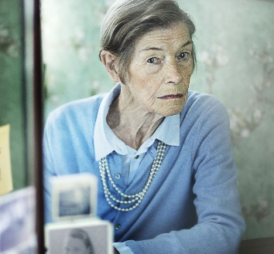
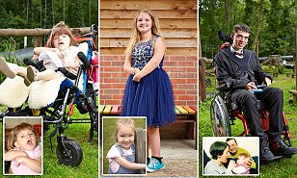
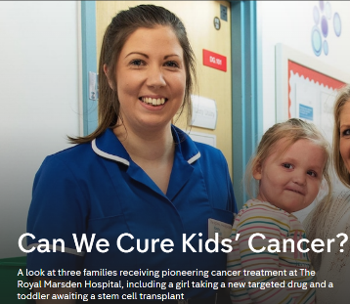
Beyond
Elizabeth is Missing
Katie Price; Harvey and Me
Jesy Nelson: Odd one out
Stacey Dooley 9-5 Care Home
BBC iPlayer
24 hours in A&E
Born to be different
The Royal Marsden
Losing it: Our mental health
All 4
Beyond weight loss
The Upside
ALLELUJAH
Miss you Already
Amazon Prime

Slide 6
Beyond
This is Going to Hurt by Adam Kay
When Breathe becomes Air by Paul Kalanithi
Pig Heart Boy by Malorie Blackman
Wonder by R.J. Palacio
Further Reading
The Hate U Give by Angie Thomas
Me Before you by Jojo Moyes
The Fault in Our Stars by John Green
The Story of Baby P by Ray James
Katie Price; Harvey
The Language of Kindness by Christie Watson
I am Malala by Malala Yousafzai
The Boy Who Couldn’t Stop Washing by Dr Judith Rapaport
Recommended Reading for T-Level Health
Yes some of these are also films, if you prefer!

Slide 7
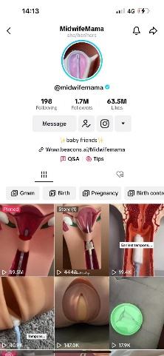
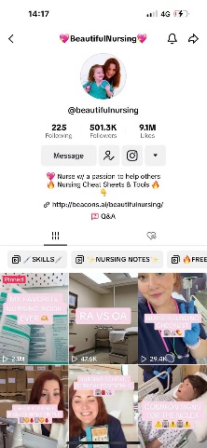
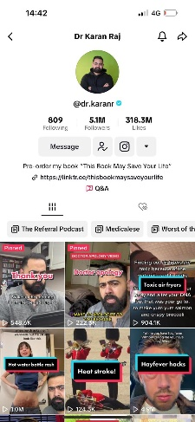
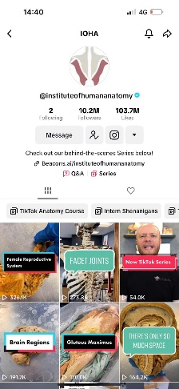
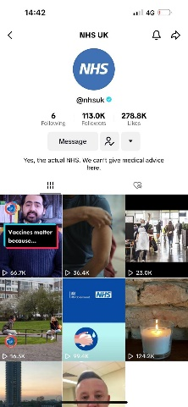
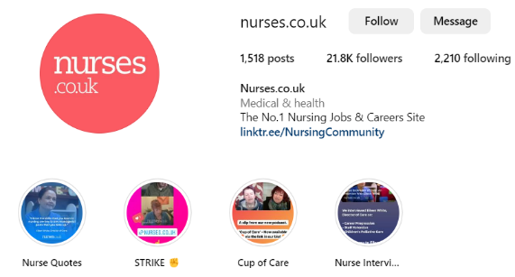
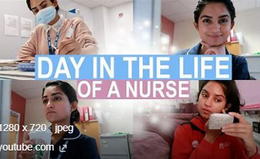
Beyond
Follow
Follow
@midwifemama
@beautifulnursing
@leilaincredible
@dr.karanr
@instituteofhumananatomy
@lubdubsblog
@nhsuk
@alliedhealthcareforme
Nurses.co.uk
@nursezara_uk
If you have any others, you think are good, let us know ☺

Slide 8
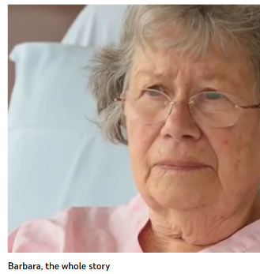
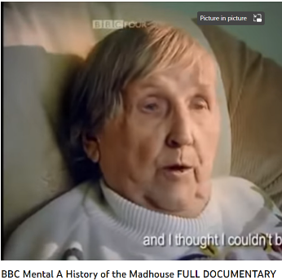
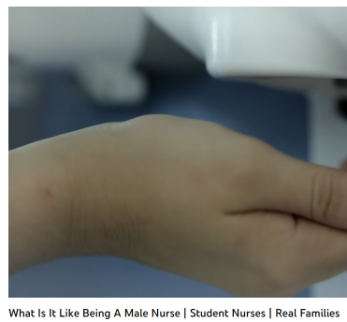
Health and Social Care in the Media
It is important to have a broad understanding of health care and social issues which affect services and professionals working for the NHS. One way of raising your awareness is to prepare you before your course starts with summer learning using different forms of media.
Your task is to pick either a film, a book or documentary from the pages above.
You are then tasked with writing a report which is to be a minimum of half an A4 page with the following title: ‘Discuss the issues [in the film/book or documentary] and impact on health care provision’
You must watch or read using examples on the previous slides or another media resource relevant to your learning.
Consider the following:
What issues, if any, are being raised in the stimulus? E.g. dementia
How does the stimulus present health? E.g. care for people with dementia
Explain why the topic of the media source is relevant to your learning and whether you think it is helpful and why?
This list is NOT exhaustive there may be other questions/ideas you wish to consider as you watch or read – it would be lovely to share with us all.

Slide 9
Task: Research and define the following words which are words you will need to use correctly. Then, end column summarise the term visually to help you remember it.
Term | Definition | Pic/image/draw
Adolescence
Advocate
Attachment
Care package
Clinical Commissioning Groups (CCGs)
Discrimination
Diversity
Empathy
Ethical

Slide 10
Term | Definition | Pic/image/draw
Fine Motor Skills
Growth
Holistic Approach
Multi-disciplinary team
Nature
Nurture
Risk Assessment
Safeguarding
Self-Esteem

Slide 11
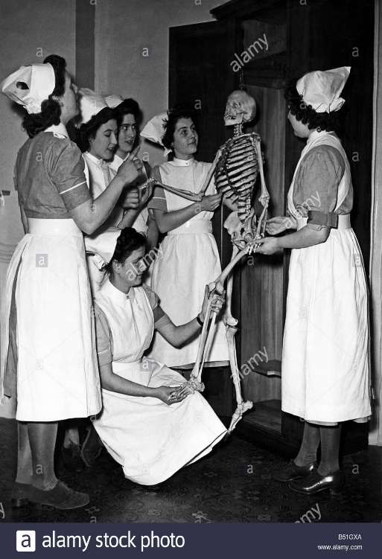
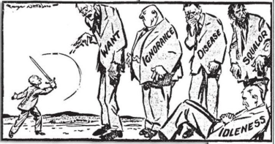
History of the NHS
Make a leaflet outlining the history of the NHS
Include sections on:
Healthcare before the NHS
When/ why the NHS was produced
What the NHS does
Significance of the NHS
How is the NHS different in other countries
The Beveridge Report, 1942
In 1942, a plan had been presented by William Beveridge, a senior civil servant, detailing key areas for post-war reconstruction, aimed at establishing a national system of welfare for the people. It identified ‘five giants’ that were to be overcome: want, disease, ignorance, squalor and idleness.
When the Beveridge Report first appeared, it was welcomed by all the parties. There was broad agreement that protection needed to be provided for all members of society, and so when Labour came to power in 1945, they implemented the proposals in this report, thereby establishing the welfare state, a system which all governments after 1951 accepted in its essentials. This common acceptance became known as consensus.
Giant | The 1945 Labour Government’s Solution
Want | To be ended by National Insurance. The National Insurance Act created a system whereby the government, employers and employees all paid for insurance which would pay out in the event of unemployment, sickness, maternity and retirement.
Disease | To be ended by a comprehensive health service. The National Heath Service Act provided free medical and hospital treatment for all (the NHS).
Ignorance | To be ended by an effective education system. The Labour Party continued to support the Conservative’s 1944 Butler Education Act which provided free education within grammar schools, technical schools or secondary schools.
Squalor | To be ended by slum clearance and rehousing
Idleness | To be ended by full employment

Slide 12
Research task
Chose a professional from the following:
Midwife
Paramedic
Paediatric nurse
Oncology nurse
Physiotherapist
You could choose your own idea from health and social care roles if you prefer.
Create a fact file for your chosen job role
You could include:
A day in the life of……
General roles and responsibilities
Routes into the role/ qualifications required
Skills & qualities
Average pay
Where they work
Who they work with
And anything else you think may be suitable
You will use this fact file during induction to create your presentation for entry onto the course.
Build your reference list – record your sources

Slide 13
True or False?
Colour code the statements in order to show if they are true or false.
True False
A palliative care nurse will get involved with everyone who gets coronavirus.
A district nurse will only work with the elderly.
A midwife works with babies and children up to 5 years
Domiciliary carers provide care in the home.
Only phlebotomists are allowed to take blood.
Auxiliary nurses help support other nurses to do their roles.

Slide 14
Passport to SCG T Level Health Check list
Use this list to make sure you have everything you need to hand in in September in order to start your T-Level Health course.
Complete homework
Complete the DBS link sent to your email. If you have not been sent this by 31st Aug 2023 please email.
Bring in GCSE results (5 x GCSE at 4 or above including maths, English and science)
Bring in all relevant paperwork for DBS
Prepare for numeracy, literacy and science assessment

